Slide 1





Global Trust Verification Platform
Empowering Trust in Web3 Through AI-Powered Identity Verification
Comprehensive Identity
Asset Authentication
Cross-Chain Interoperability
1

Slide 2







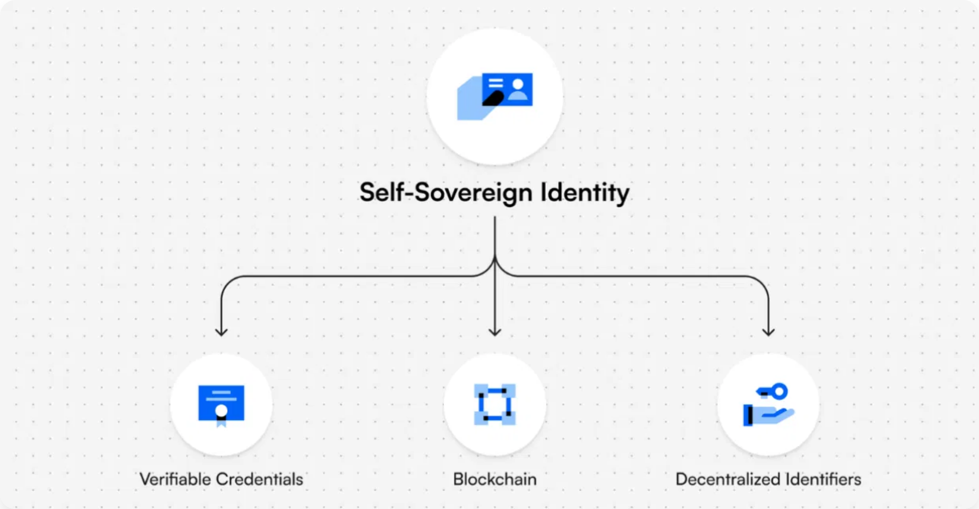

The Problem
Current Web3 Challenges:
Pain Points:
Identity Fragmentation
- Multiple wallets, no unified
Users can't prove their reputation across chains
reputation
Assets can be easily faked or manipulated
Asset Authenticity
- No way to verify digital asset
No standardized verification system
legitimacy
High friction in cross-chain transactions
Cross-Chain Complexity
- Isolated blockchain ecosystems
Trust Deficiency
- 60% of users don't trust DeFi platforms
Fraud & Scams
- $3.8B lost to crypto fraud in 2022
2

Slide 3









Our Solution
Comprehensive Trust Infrastructure
Decentralized Identity
Self-sovereign identity with reputation
Privacy-preserving verification
Cross-chain reputation portability
AI-Powered Verification
Document authenticity detection
Asset valuation & fraud scoring
Behavioral pattern analysis
Cross-Chain Bridge
Seamless asset transfer
Real-time fee calculation
Complete transaction audit trails
Additional Components:
Verified Marketplace
DeFi Lending
3

Slide 4






Technology Architecture
Built on Internet Computer Protocol
Cross-Chain Integration
Backend Canister
AI Verifier
₿
Bitcoin bridge
Core identity & file services
Machine learning verification engine
Ξ
Ethereum bridge
◎
Solana bridge
Marketplace
Lending
∞
Native ICP
Asset trading with confidence scoring
DeFi protocols for verified assets
AI/ML Stack
Frontend
Document OCR & authenticity detection
React-based user interface
Behavioral analysis algorithms
Fraud scoring models
Asset valuation engines
4

Slide 5


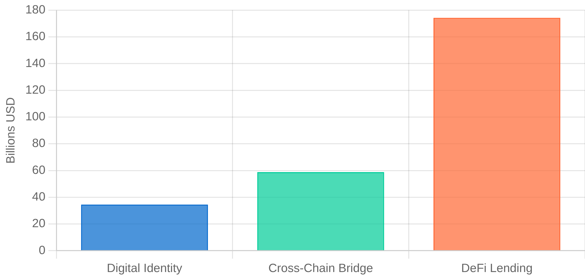




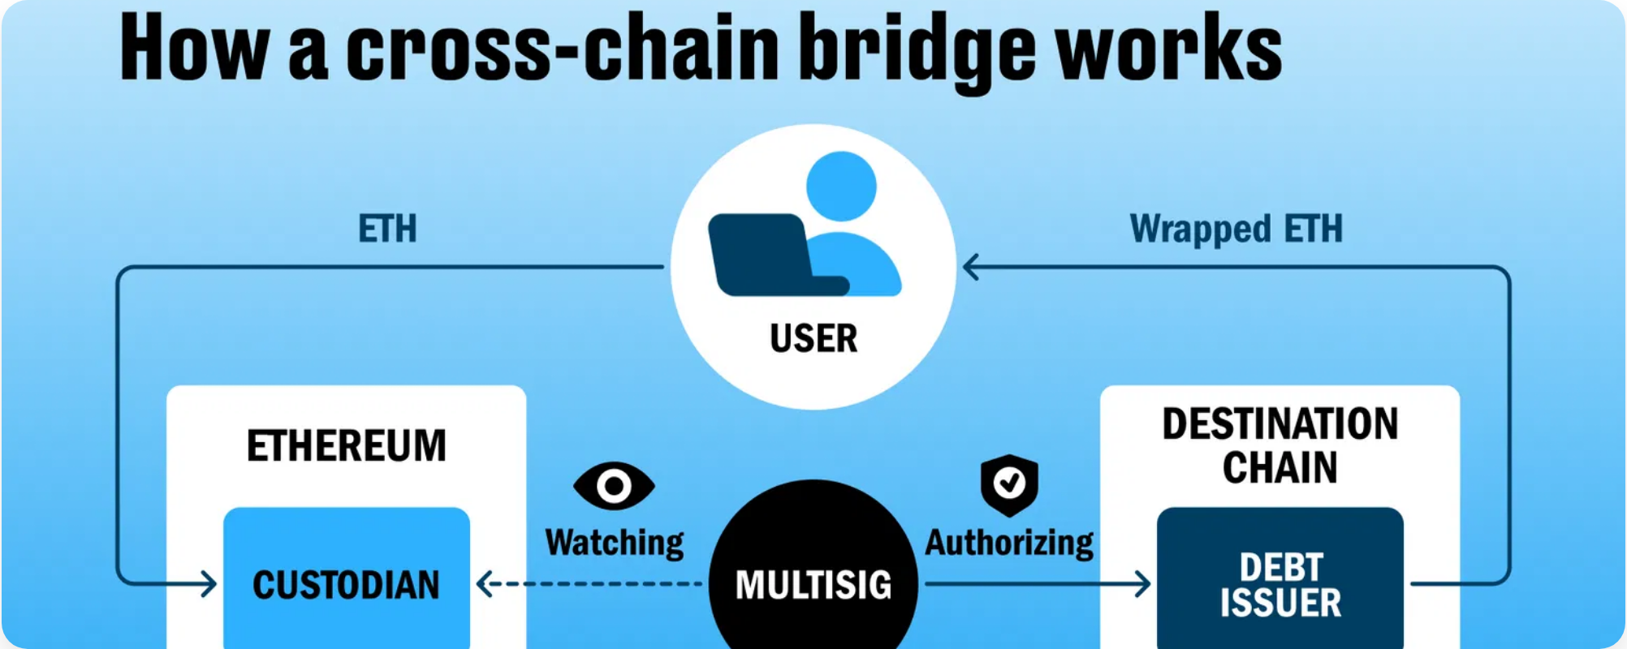
Market Opportunity
Total Addressable Market (TAM):
Target Users:
Primary:
DeFi users seeking reputation portability (50M users)
Secondary:
NFT traders needing authenticity verification (25M
users)
Tertiary:
Cross-chain traders (15M users)
Market Validation:
95% of surveyed users want cross-chain reputation
78% would pay premium for verified assets
$3.8B annual fraud loss creates massive demand
5

Slide 6


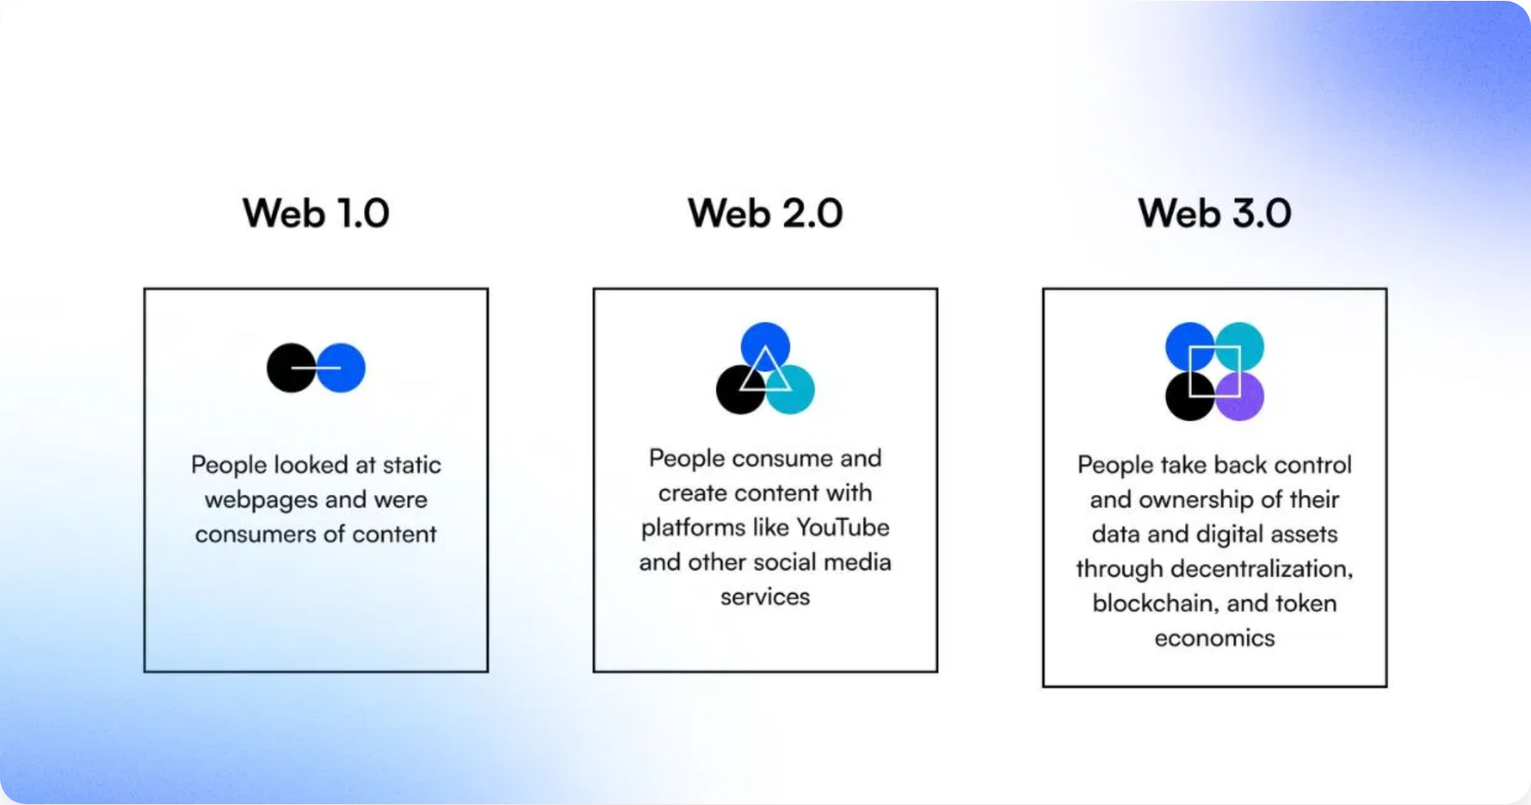












Competitive Advantage
What Makes Us Different:
Feature
Competitors
Global Trust
Cross-Chain Identity
Single chain
4+ chains
AI Verification
Basic/None
Multi-model AI
Asset Marketplace
Separate platforms
Integrated
DeFi Integration
Limited
Full lending suite
Privacy Controls
All-or-nothing
Granular settings
Technical Advantages:
Internet Computer Speed
- Sub-second finality
Cost Efficiency
- 99% lower than Ethereum
Scalability
- Unlimited throughput
Security
- Chain-key cryptography
6

Slide 7




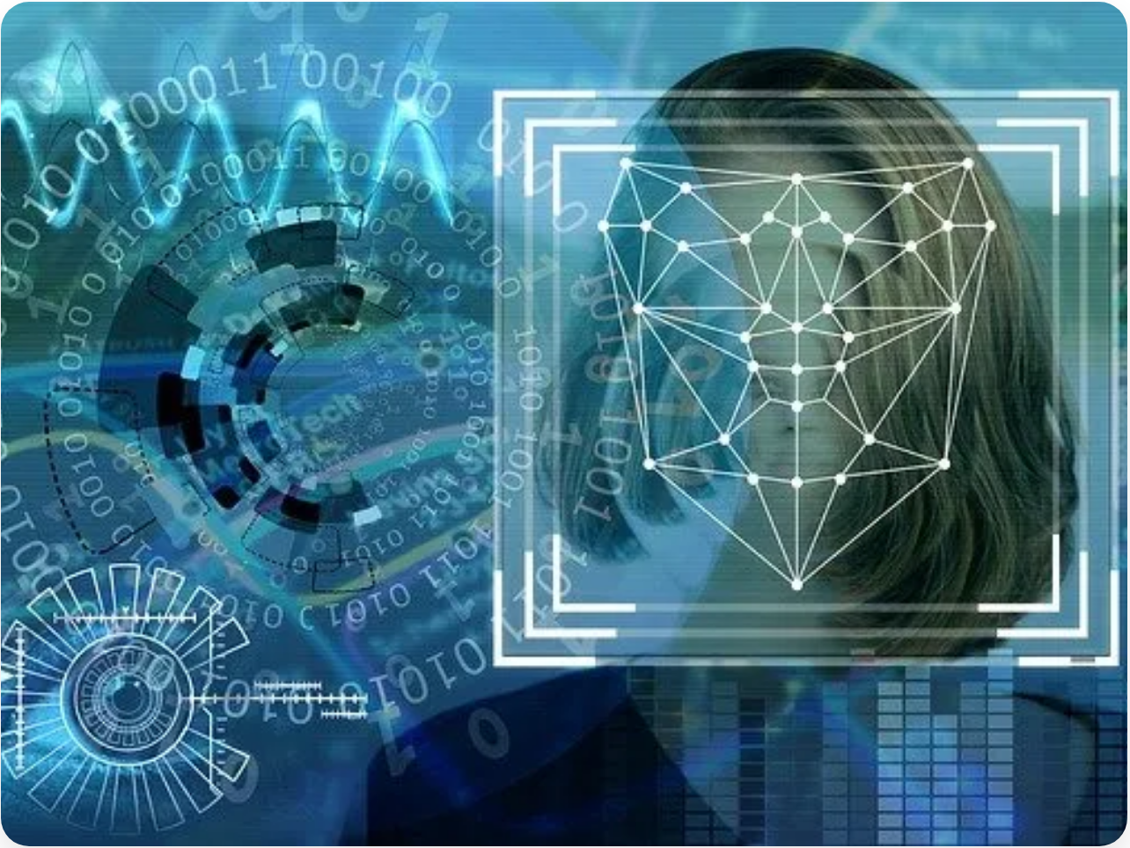



Product Demo
Live Demo Features:
Identity Creation
File Storage & Verification
DID:
did:icp:177a76b655d1e2b6ebd32da4ef46257a
Upload:
test_document.txt (38 bytes)
Score:
55.0/100
Controls:
Privacy settings enabled
Hash:
90d85cbe4e80ec4c...
AI Score:
Authenticity verified
Cross-Chain Bridge
Marketplace Listing
Transfer:
Bitcoin → Ethereum
Asset:
Test Document ($1,000 value)
Amount:
50,000 units
Fee:
1,250 (0.5%) + 1,000 fixed
Score:
0.95/1.0 verification
Lending Offers
Price:
$1,500 listing
Offer 1:
$50K max loan (12.5% APR)
Offer 2:
$10K max loan (8.0% APR)
Live URLs:
Terms:
365-day terms
Frontend:
http://be2us-64aaa-aaaaa-qaabq-cai.localhost:4943/
Candid UI:
http://127.0.0.1:4943/
7

Slide 8


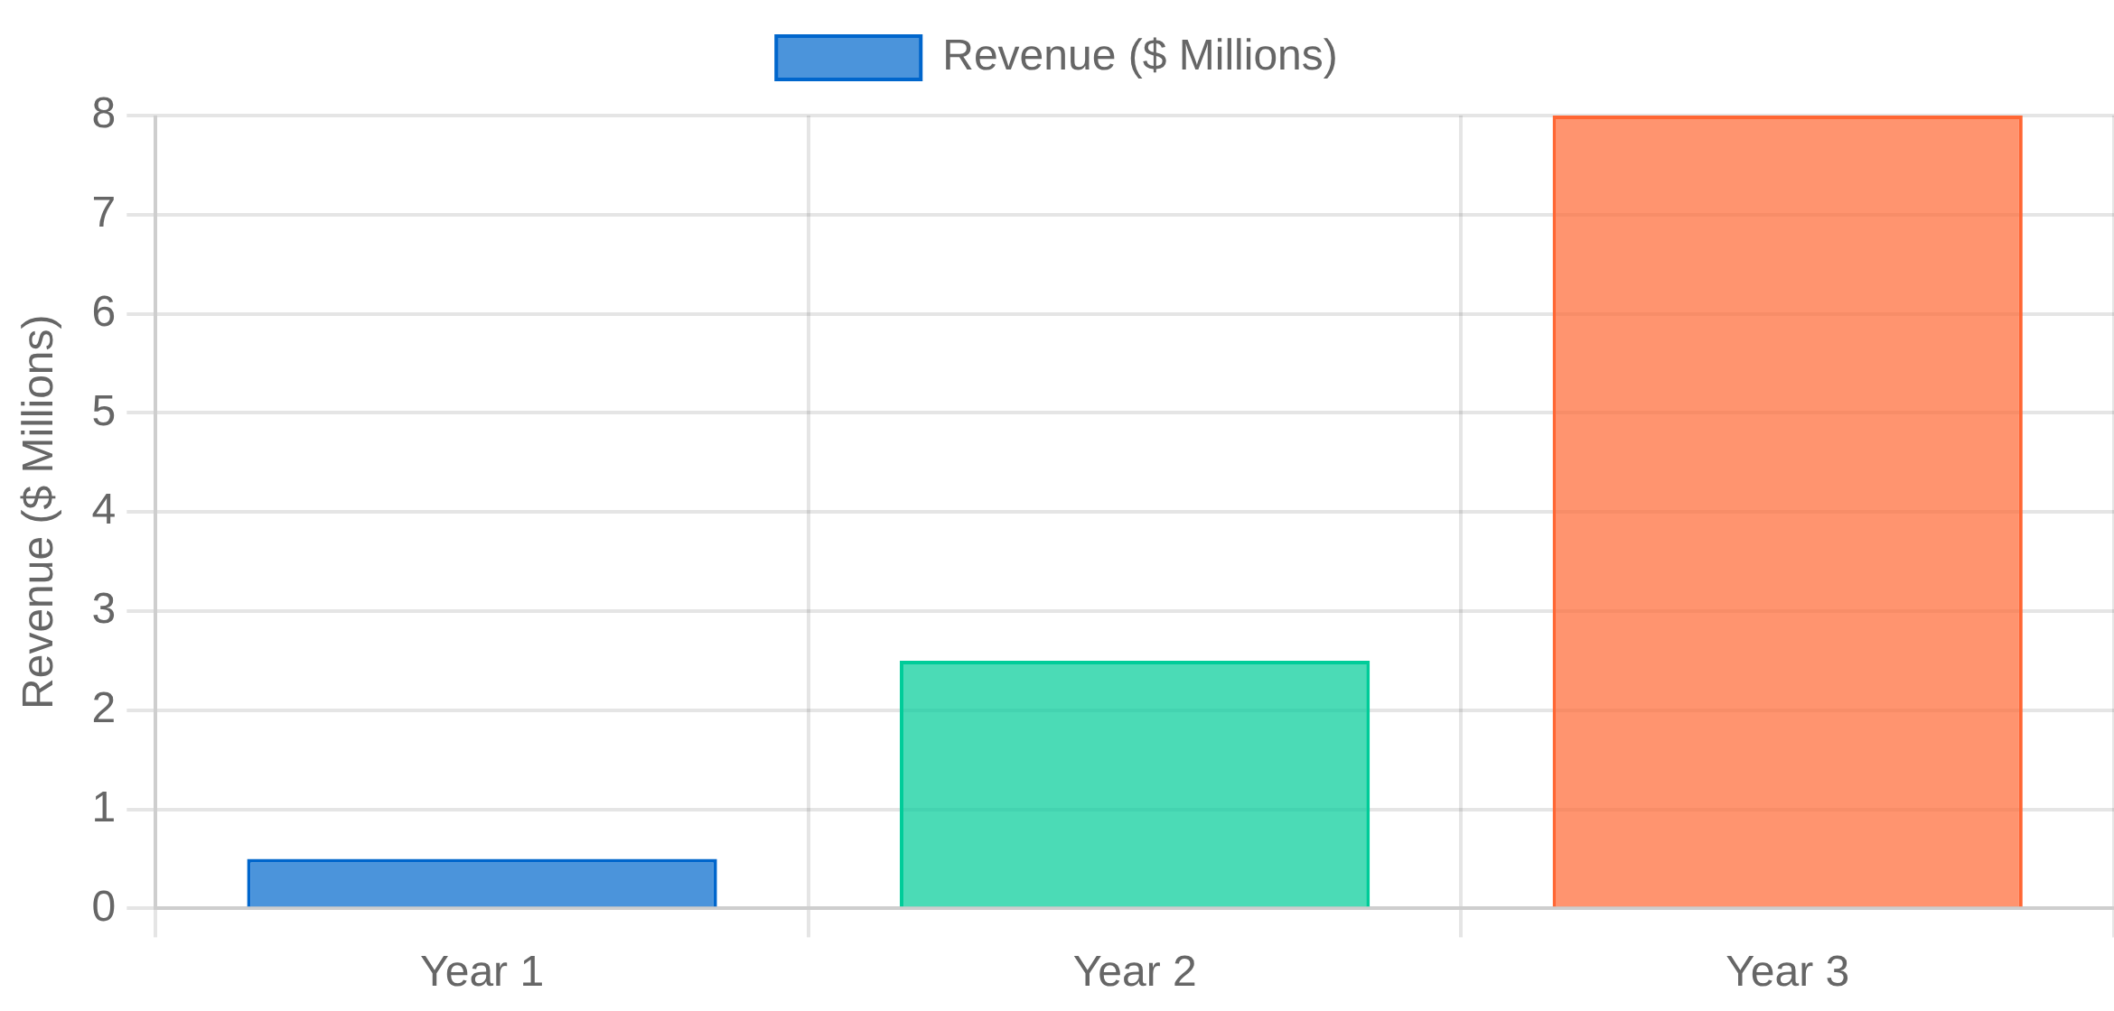

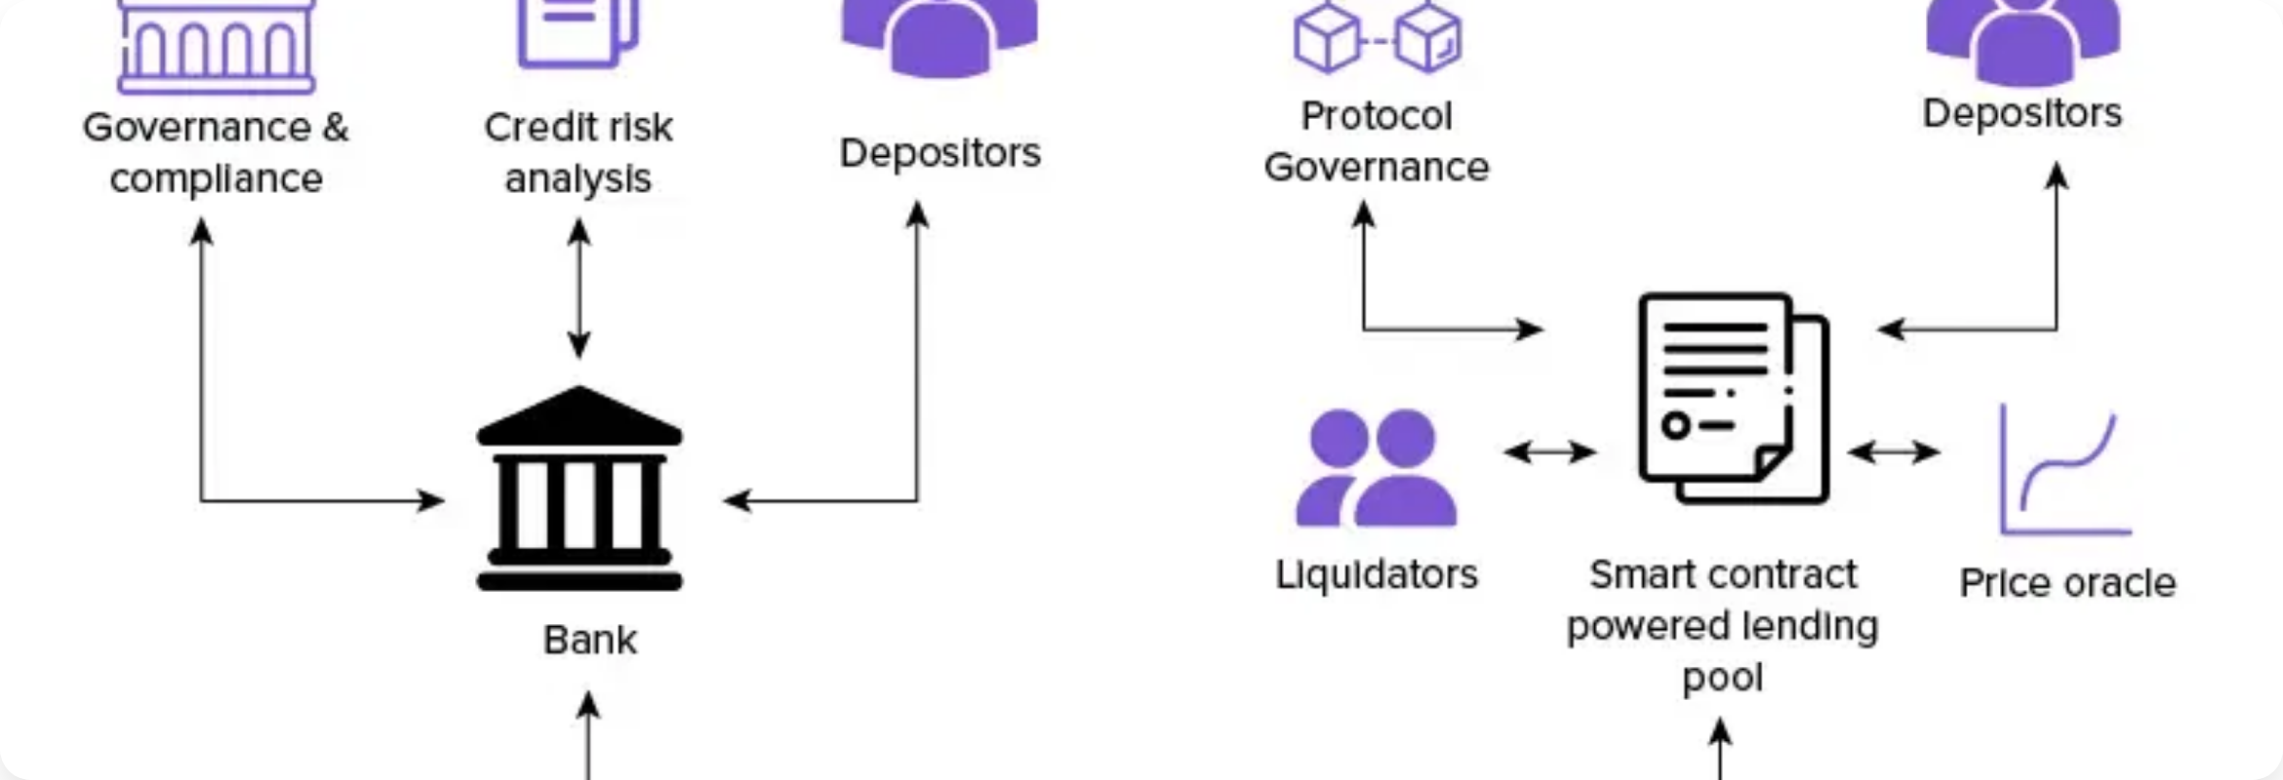

Business Model
Revenue Streams:
Revenue Projections:
Transaction Fees
60%
Bridge transfers:
0.2-0.5% per transaction
Marketplace trades:
2.5% commission
Lending protocol:
10% of interest earned
Premium Verification
25%
Enhanced AI verification:
$10-50 per asset
Enterprise API access:
$1,000-10,000/month
White-label solutions:
$50,000+ licensing
Data & Analytics
15%
Reputation scoring API:
$0.10 per query
Fraud detection services:
$5,000/month
Market intelligence reports:
$500/report
8

Slide 9






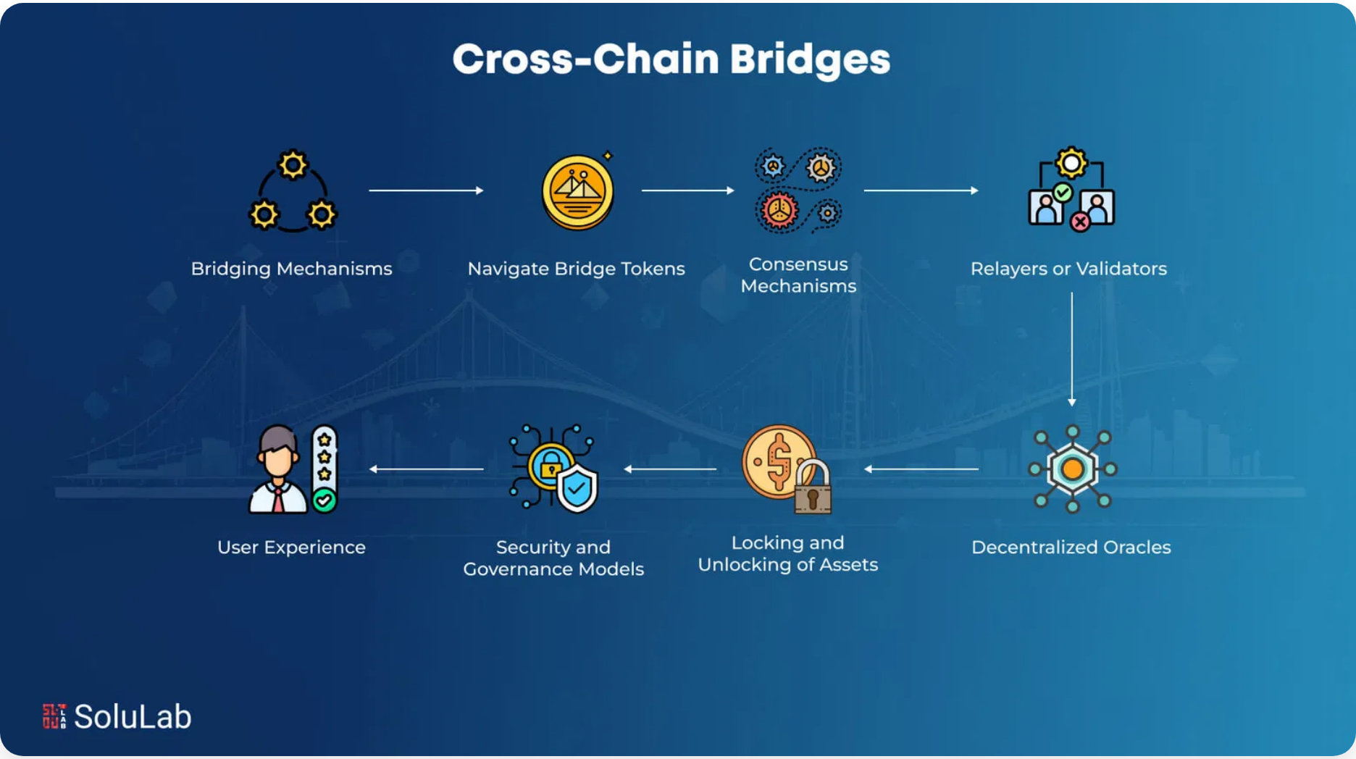











Go-to-Market Strategy
1
2
3
Community Building
Ecosystem Integration
Scale & Expand
Months 1-6
Months 6-12
Months 12-24
Launch on ICP mainnet
Integrate with major wallets
Additional blockchain integrations
Partner with existing DeFi protocols
List on DeFi aggregators
Enterprise API launches
Developer hackathons & bounties
Cross-chain partnerships
Mobile application release
Social media & content marketing
Institutional pilot programs
International market expansion
Key Partnerships:
ICP Ecosystem
Cross-Chain
DeFi
DFINITY Foundation
Chainlink
Uniswap
ICP.Hub
LayerZero
Compound
Wormhole
Aave integrations
9

Slide 10



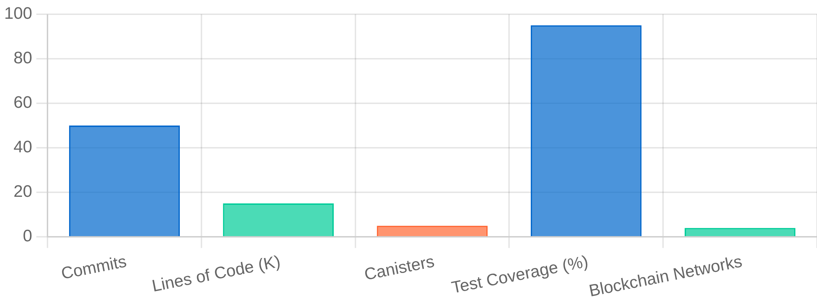

Team & Execution
Core Team:
Development Progress:
Technical Leadership:
MVP Complete
- 5 working canisters deployed
Frontend Integration
- Full React UI with real-time data
Lead Developer
AI/ML Engineer
5+ years blockchain development
PhD Computer Science, fraud detection expert
Cross-Chain Bridge
- Bitcoin, Ethereum, Solana support
AI Verification
- Document authenticity & fraud scoring
Full-Stack Developer
DevOps Engineer
Marketplace & Lending
- Complete DeFi ecosystem
React/Rust specialist
Infrastructure & security focus
Development Metrics:
Advisors:
ICP Ecosystem Expert
DeFi Pioneer
Former DFINITY team member
Early Ethereum developer
Enterprise Sales
B2B SaaS background
10

Slide 11




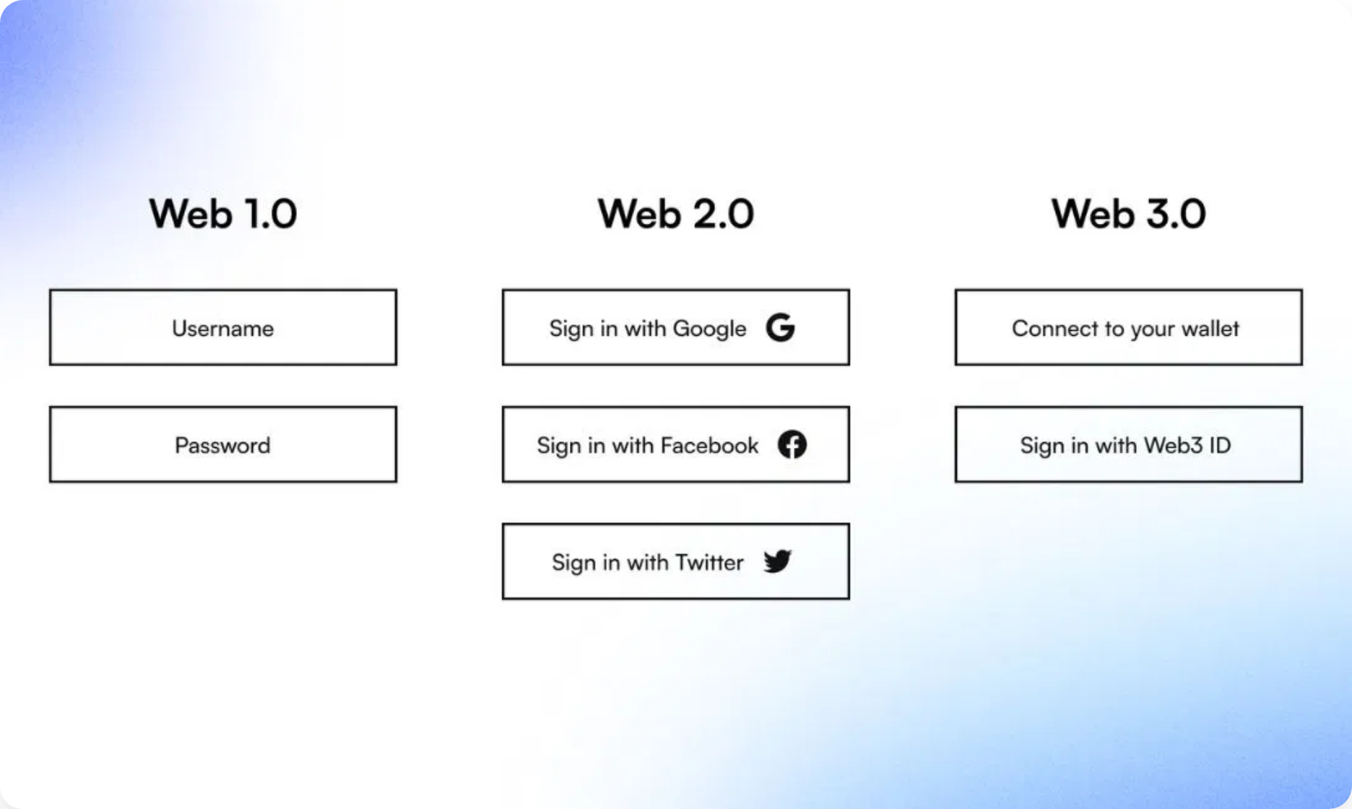






Roadmap & Vision
Next 6 Months:
Q1 2025:
ICP mainnet deployment & security audits
Q2 2025:
Mobile app beta & additional chain integrations
Next 12 Months:
Q3 2025:
Enterprise API launch & institutional partnerships
Q4 2025:
Advanced AI models & machine learning optimization
Long-term Vision (2-3 Years):
Universal Identity Standard
- Become the de-facto cross-chain identity protocol
"To create a trustworthy, verifiable foundation for the decentralized internet where reputation, assets, and identity can seamlessly traverse all blockchain networks."
AI Trust Infrastructure
- Power verification for the entire Web3 ecosystem
Global Adoption
- 1M+ verified identities across all major chains
Enterprise Integration
- B2B verification services for traditional companies
11

Slide 12





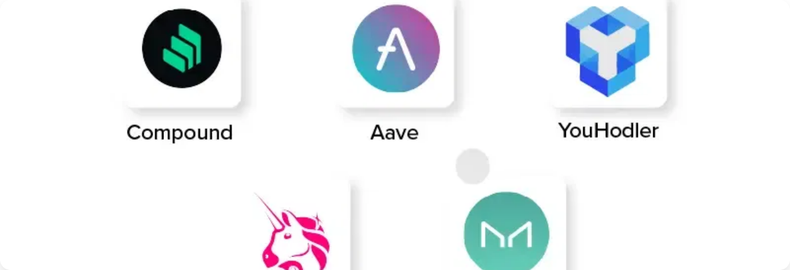

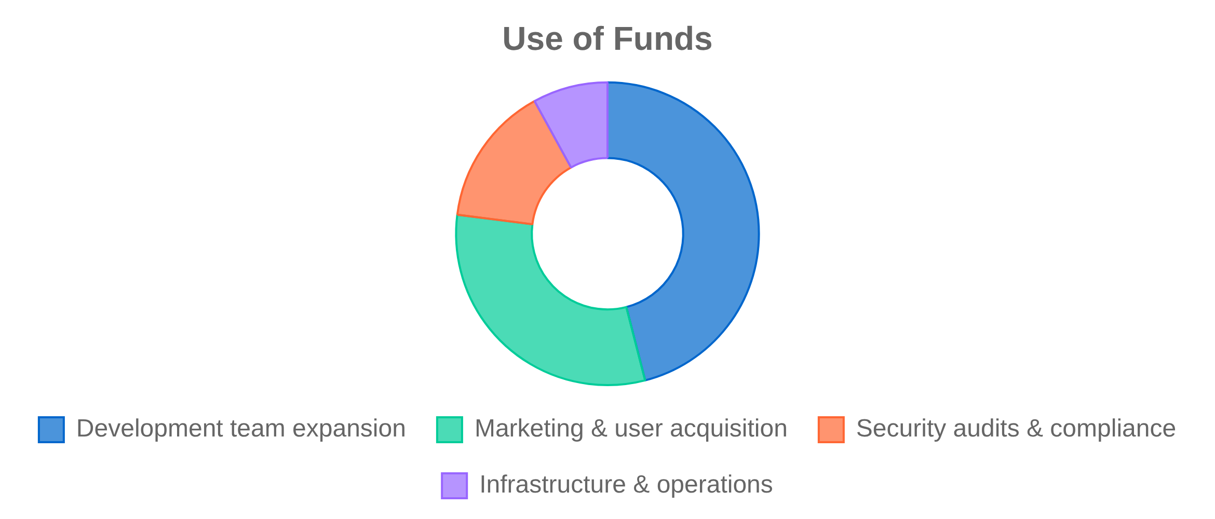
Ask & Investment
What We're Seeking:
What You Get:
Security Audits
Proven Technology
- Working MVP with 95% test coverage
Comprehensive smart contract audits
Market Opportunity
- $34.5B+ addressable market
$50K
Marketing & Growth
Strong Team
- Experienced blockchain developers
User acquisition campaigns
ICP Ecosystem
- Built on cutting-edge infrastructure
$100K
First-Mover Advantage
- Comprehensive cross-chain identity
Team Expansion
solution
Additional developers & designers
$150K
Infrastructure
Mainnet deployment & scaling
$25K
Total Ask: $325K for 18-month runway
13

